Slide 1
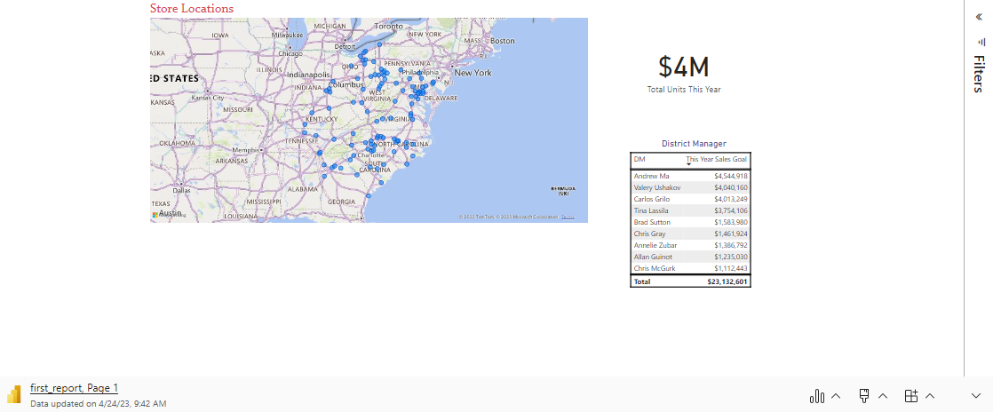

Slide 2
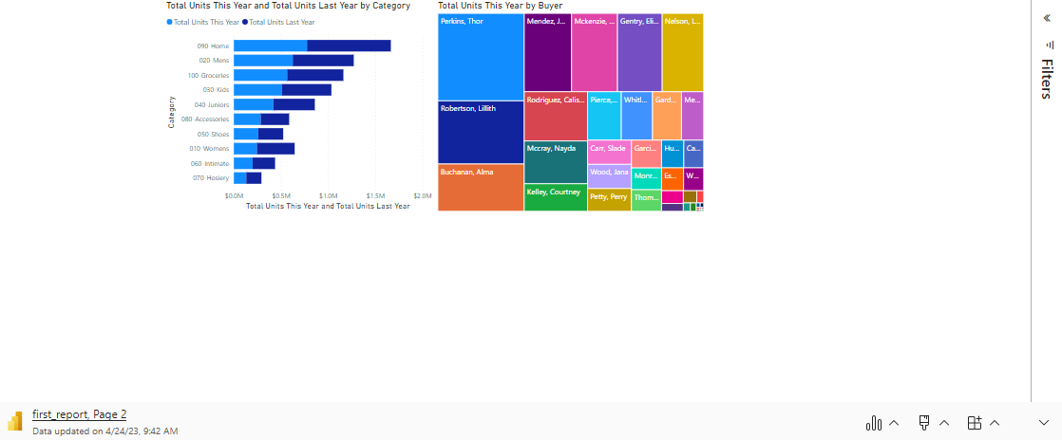

Slide 3
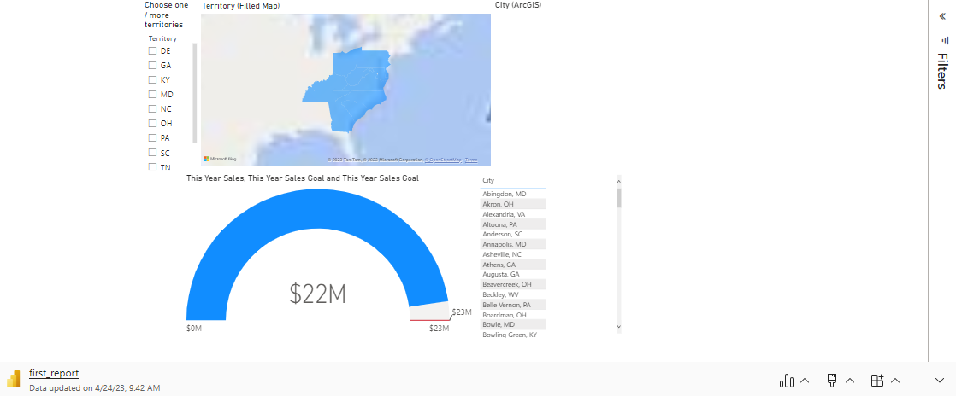

Slide 4

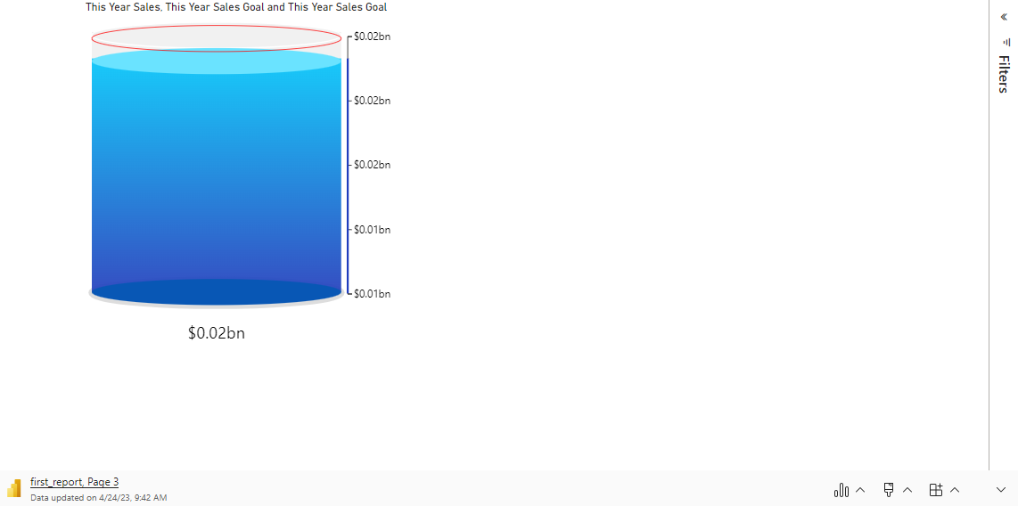
Microsoft Power BI

Slide 5

Relaunch the add-in
Microsoft Power BI
After you install the add-in, you can launch it by choosing the add-in button on the Insert tab
On the Insert tab
Insert
My Add-ins
Need more help?
Return to your internet browser or copy this link into your browser:
https://pages.store.office.com/addinsinstallpage.aspx?rs=en-US&assetid=WA200003233&isWac=True&ui=en-US&ad=US

